Slide 1
Mechanical Work

Slide 2
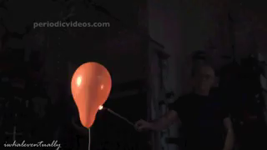
In this Smart Lesson you will learn to:
Explain that a system with thermal energy has the capacity to do work.
Recall that the change in the internal energy of a system is equal to the energy added or removed by heating plus the work done on or by the system.
Outline the first law of thermodynamics and understand how it is derived from the law of conservation of energy.

Slide 3

A system with thermal energy has the capacity to do mechanical work.
So what is mechanical work?
You may already have come across work defined as the energy transferred by a force:
W=Fd, where W=work, F=force and d=distance.

Slide 4
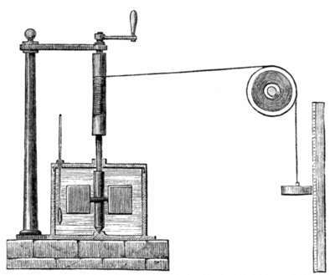
But how can heat energy have a mechanical equivalent?
Back in 1845, the English scientist James Joule was working on this problem.
He did a classic experiment where he set up a system where a falling weight was used to turn a paddle wheel inside an insulated barrel of water. As the paddle when turned, there was friction against the water, causing an increase in temperature.
He used this to calculate the mechanical equivalent of heat.

Slide 5
In thermodynamics, the work done by a system is described as the energy transferred by the system to its surroundings.
Even though there is no measurable force, a system with thermal energy has the capacity to do mechanical work.

Slide 6
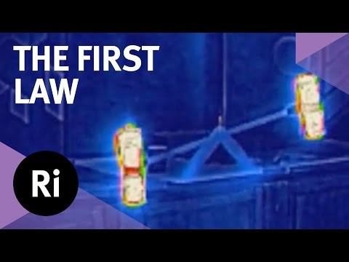

Slide 7

The first law of thermodynamics.
The law of conservation of energy states that in a closed system, energy can neither be created nor destroyed, but only transformed into different forms or transferred.
The first law of thermodynamics states that the change in internal energy (ΔU) of a system equals the heat transferred between the system and its surroundings (Q) plus the work done by or on the system (W).
ΔU=Q+W

Slide 8
So how does the internal energy relate to the law of conservation of energy?
If a system is heated or work is done on a system, the internal energy increases.
Conversely, if a system loses heat or does work on the surroundings, the internal energy decreases.
In order for the law of conservation of energy to be true, the total energy change must sum to zero. Therefore, if energy is lost by the system, it is gained by the surroundings. If energy is gained by the system, it is lost from the surroundings.
ΔU_{system}​=−ΔU_{surroundings​}

Slide 9
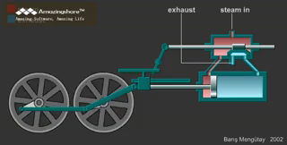
A steam engine is an example of how thermal energy can be used to do mechanical work.
In a steam engine, water is heated and turns to steam. As it vaporises, it occupies a much larger volume than the liquid, which increases the pressure. This high pressure steam is used to move pistons back and forth and this movement can be used, for example to turn the wheels on a train.

